Slide 1
SOA SERVICE ORIENTED ARCHITECTURE

Slide 2
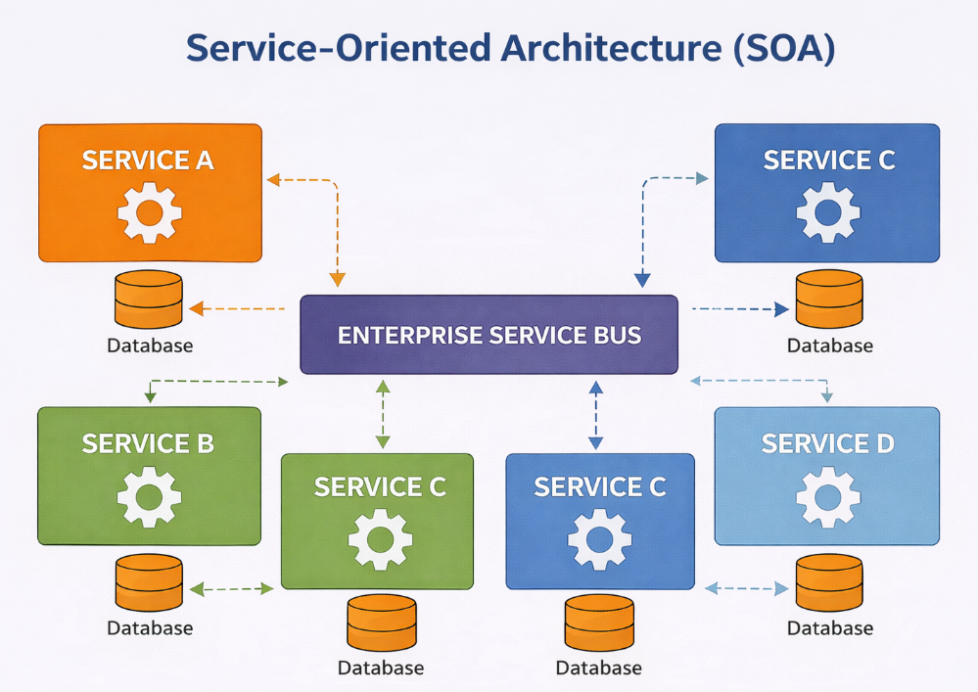

Slide 3
Definition
SOA (Service-Oriented Architecture) is a software design approach where an application is divided into small, independent services. These services communicate with each other through a network to complete business tasks.

Slide 4
SOA stands for Service-Oriented Architecture.
SOA is a software architecture.
It divides a large application into small services.

Slide 5
Each service performs one specific task.
Services work independently.
Services communicate through a network.

Slide 6
Communication happens using APIs.
SOAP and REST are common communication methods.
Each service has its own responsibility.

Slide 7
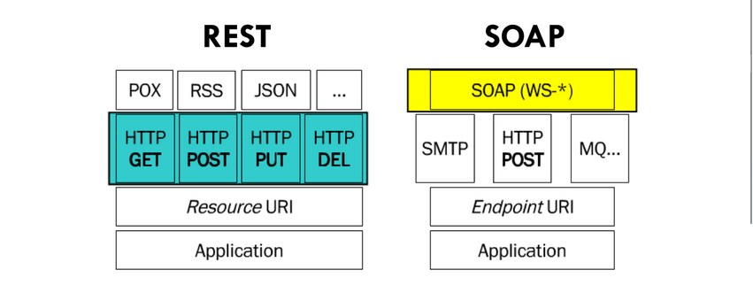

Slide 8
Services can be developed separately.
Services can be tested independently.
Services can be updated without affecting the whole system.

Slide 9
SOA makes software easy to maintain.
SOA improves software flexibility.
SOA supports code reusability.

Slide 10
One service can be used by many applications.
SOA reduces duplicate work.
SOA saves development time.

Slide 11
SOA improves productivity.
Different teams can build different services.
Services can use different programming languages.

Slide 12
Java, Python, and .NET services can work together.
SOA supports platform independence.
Services exchange data using standard formats like XML or JSON.

Slide 13
SOA is suitable for large business applications.
Banking systems use SOA.
E-commerce websites use SOA.

Slide 14
Hospital management systems use SOA.
Airline reservation systems use SOA.
Government applications also use SOA.

Slide 15
SOA makes adding new features easier.
Services can be reused in future projects.
SOA improves system scalability.

Slide 16
Only busy services need more resources.
SOA reduces maintenance cost.
Errors in one service do not always affect other services.

Slide 17
Services are loosely coupled.
Loose coupling makes the system more flexible.
SOA supports distributed systems.

Slide 18
SOA improves business process integration.
Security can be managed for each service.
SOA supports cloud applications.

Slide 19
SOA allows faster software updates.
It improves customer service by making applications more reliable.
Network communication may increase response time.

Slide 20
Managing many services can be difficult.
SOA requires proper service management.
Monitoring services is important in SOA.

Slide 21
SOA helps organizations build reliable software.
SOA is widely used in modern enterprise
applications.

Slide 22
Advantages of SOA
Easy to maintain.
Services are reusable.
Easy to update.
Saves development time

Slide 23
Supports scalability.
Platform independent.
Flexible architecture.

Slide 24
Easy integration with other systems.
Faster application development.
Better business process management.

Slide 25
Disadvantages of SOA
Depends on network communication.
Network delay can reduce performance.
Configuration is more complex.

Slide 26
Security needs extra attention.
Managing many services is difficult.
Testing the complete system can take more time.

Slide 27
Service monitoring is required.
Initial setup cost may be high.

Slide 28
Real-Life Example
An Online Shopping System uses different services:
User Service – Login and Registration
Product Service – Display Products

Slide 29
Order Service – Place Orders
Payment Service – Process Payments
Delivery Service – Track and Deliver Orders

